Slide 1
Strangers and Community Harmony
Crime and Society
Adam Crymble

Slide 2
Next Week’s Prep
L. M. Cullen, ‘Catholics Under the Penal Laws’, Eighteenth-Century Ireland, 1 (1986), 23-36.
Instead of answering the usual list of questions, once you have read the article, I would like you to write a short (250-300 words) paragraph on the aspect of the article that interested or intrigued you most. You might focus on the historiographical contexts and implications, the details of the circumstances described in the article, or the author’s arguments. You might find some other aspect of the article interesting. You should bring your work to class and be prepared to share it with the group.

Slide 3
Outline
Early Modern Community
Immigrants
Internal Migrants

Slide 4
Caveat on the Ideal

Slide 5
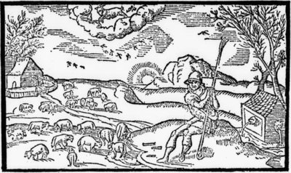
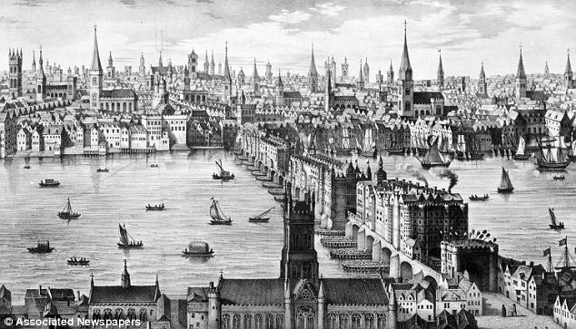
Diversity of Communities
Rural
Small Villages
Coastal Communities
Industry-Focused
Larger Towns
Major Cities

Slide 6
The Parish
Religious Centre
Continuity and Cohesion
Local Administrative Unit
A Patchwork of Parishes – a place for everyone
Medieval Parish

Slide 7
‘In Group’ vs. ‘Out Group’

Slide 8
Disrupting the Community
Reformation ends religious ‘uniformity’
Outsiders within the neighbourhood
Local schism
Cardinal Wolsey – 16th century

Slide 9
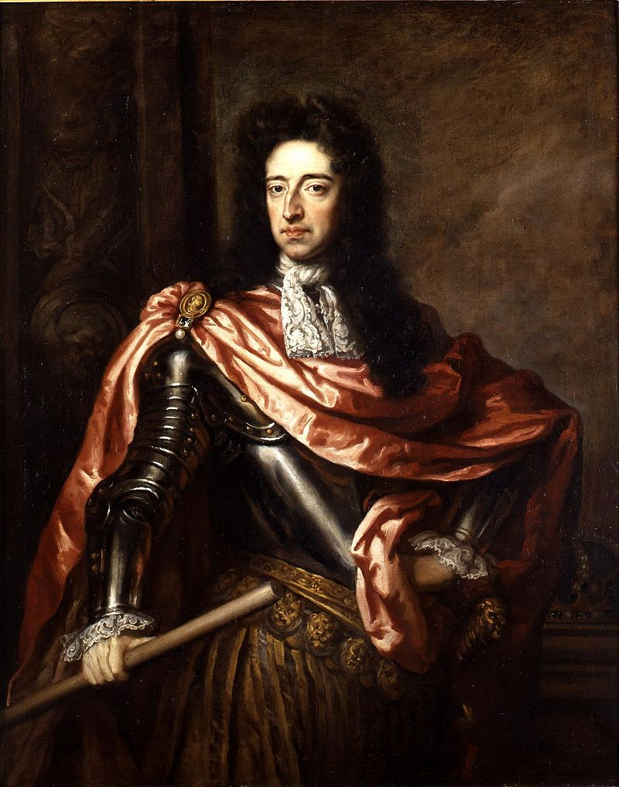
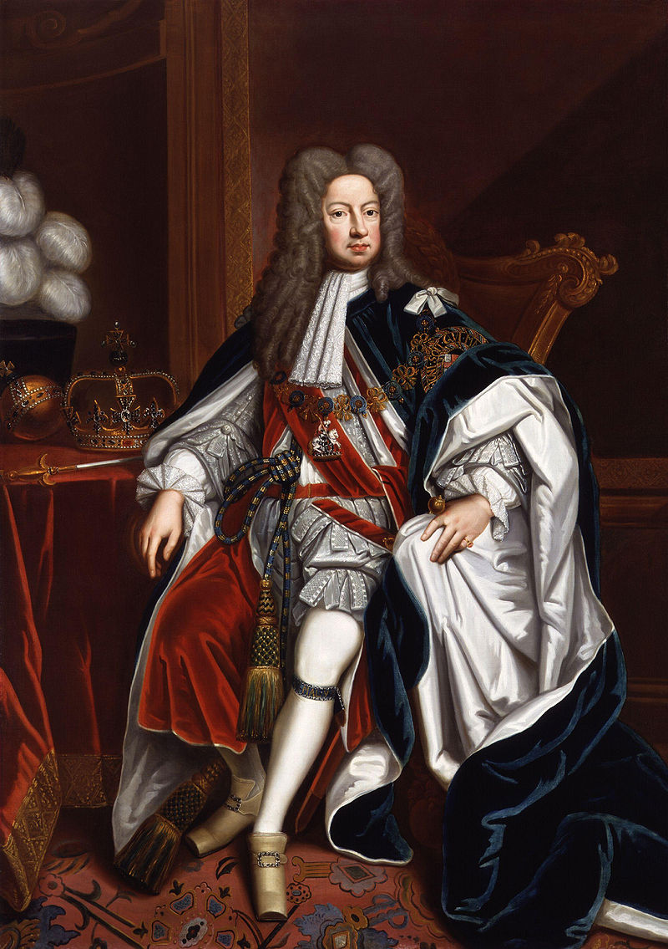
Regal Immigrants
King William III, c. 1680s
King George I, c. 1714

Slide 10
William III
Glorious Revolution – 1689
Dutchman married to English princess, Mary
Big effect on law; especially ‘Penal Laws’ in Ireland
King William III, c. 1680s

Slide 11
German Immigrants
16th century: could name them individually
Hans Holbein (painter)
George Handel (composer)
18th century: 30k-40k?
Courtiers
Everyday people
Focus on London
King George I, c. 1714

Slide 12
Responses to Immigrant Crime
More/differently criminal?
Were locals more suspicious?
Receive harsher punishments?
Problem of sources:
Schmidt = Smith?
Who is an immigrant?

Slide 13
Discretionary Justice
Community Resolution

Slide 14
English Strangers

Slide 15
Permanent Migrants

Slide 16
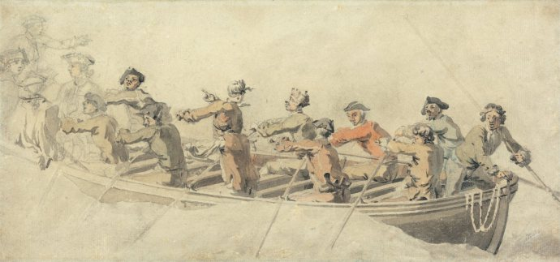
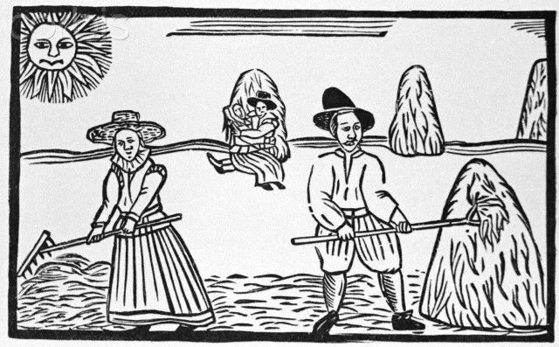
Temporary Migrants
Sailors
Transient workers
Temporary agricultural labourers
Irish, Scottish, English

Slide 17
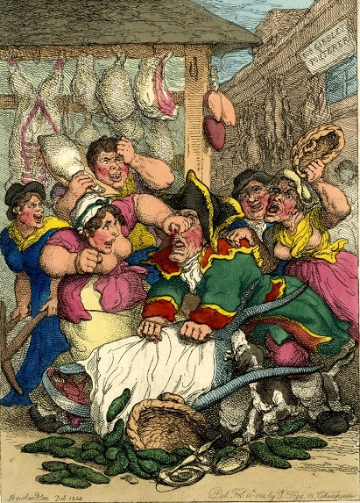
Anti-Irish Riots - 1736

Slide 18
Conclusion
Early Modern Community
Immigrants
Internal Migrants

