Slide 1
Intro to Programming (Python)
Adam Crymble

Slide 2
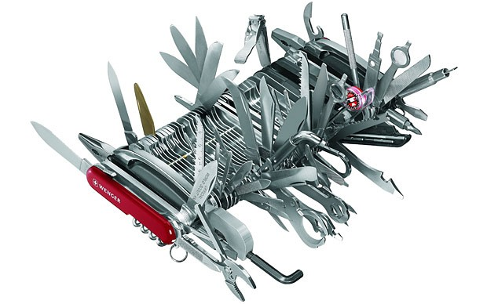
Computer Programming

Slide 3
Manipulating Data

Slide 4
Short Programs
myText = ‘ABC’
print(myText.lower())
> abc

Slide 5
Flexibility
“If you don’t program, your research process will always be at the mercy of those who do”.

Slide 6
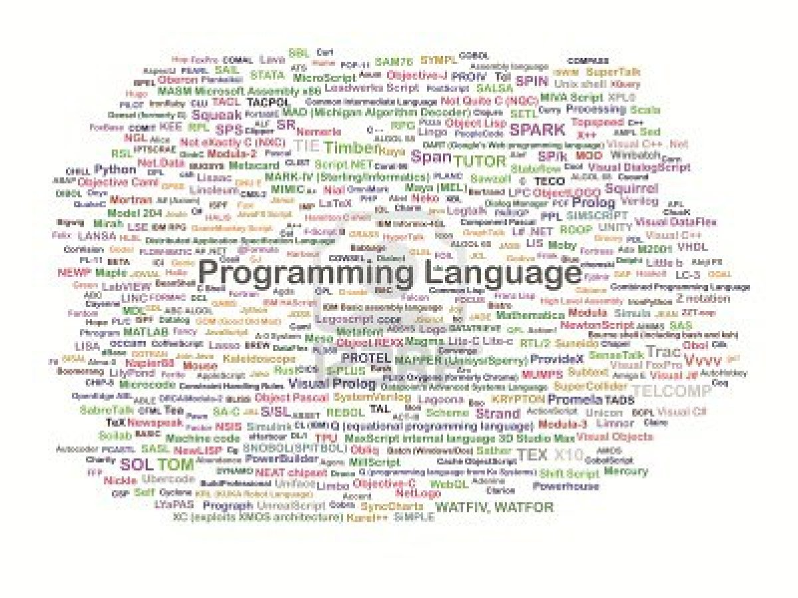
Languages

Slide 7
Python

Slide 8
Activity 1
Begin the ‘Code Academy’ tutorials for Python.

