Slide 1
Crowdsourcing
Adam Crymble
Intro to Digital History

Slide 2
Captcha

Slide 3
Re-Captcha

Slide 4
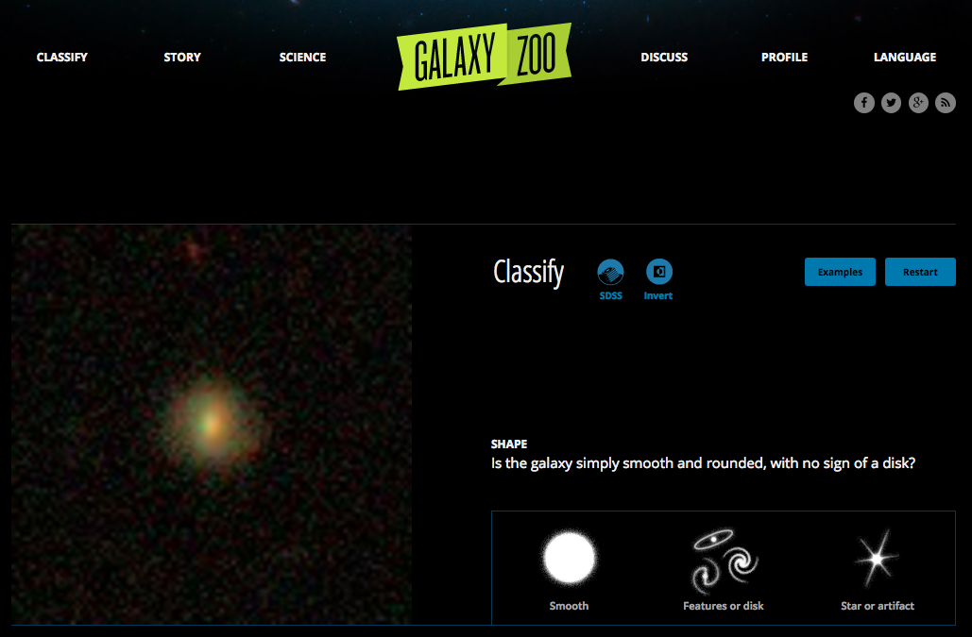
Simple Crowdsourcing

Slide 5
Wikipedia

Slide 6
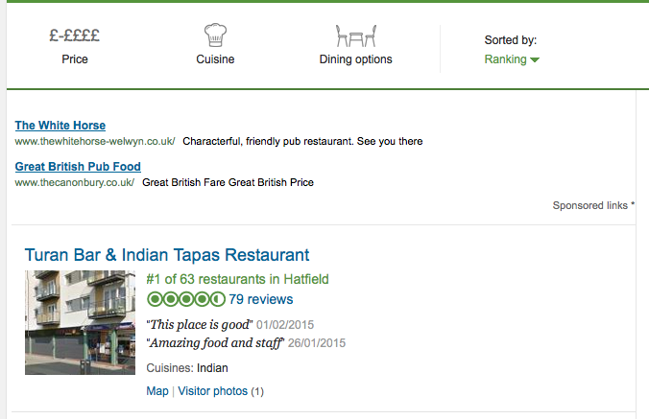
Commercial Crowdsourcing

Slide 7
Historical Crowdsourcing

Slide 8
Old Weather

Slide 9
Old Weather - Gamification

Slide 10
Old Weather - Gamification

Slide 11
Trove – Australian Newspapers

Slide 12
Georeferencing Maps

Slide 13
Citizen Scientist / Historian

Slide 14
Activity 1
Try out Old Weather and the Bentham Project (15 minutes on each).
Think about the user experience they offer. Is there anything you like about it? Anything you would change? Think about their goals, not just your personal interests.

Slide 15
Activity 2
What could we get the crowd to help us do with the Old Bailey Online?
http://www.oldbaileyonline.org
Consider:
Audience (older people, students, women?)
Approach (serious, fun, quirky, academic?)
What can you draw from the projects you tried? What would you avoid?
How are you going to measure success? (High # of contributions per person? Get it done but who cares who does it? Lots of media attention?)

Slide 16
Activity 3
What could we get the crowd to help us do with the British Library Flickr collection?
http://www.flickr.com/photos/britishlibrary
Consider:
Audience (older people, students, women?)
Approach (serious, fun, quirky, academic?)
What can you draw from the projects you tried? What would you avoid?
How are you going to measure success? (High # of contributions per person? Get it done but who cares who does it? Lots of media attention?)

