Slide 1
Data Visualisation
Adam Crymble
Intro to Digital History

Slide 2
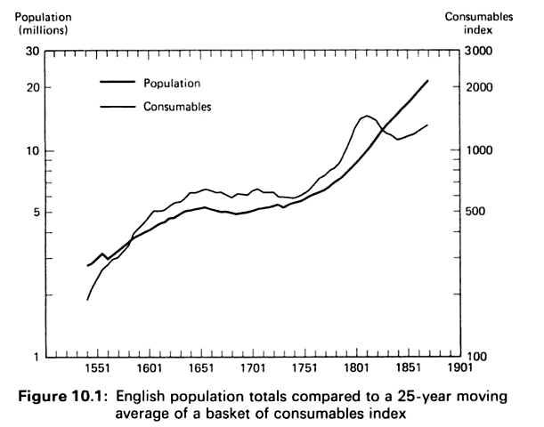
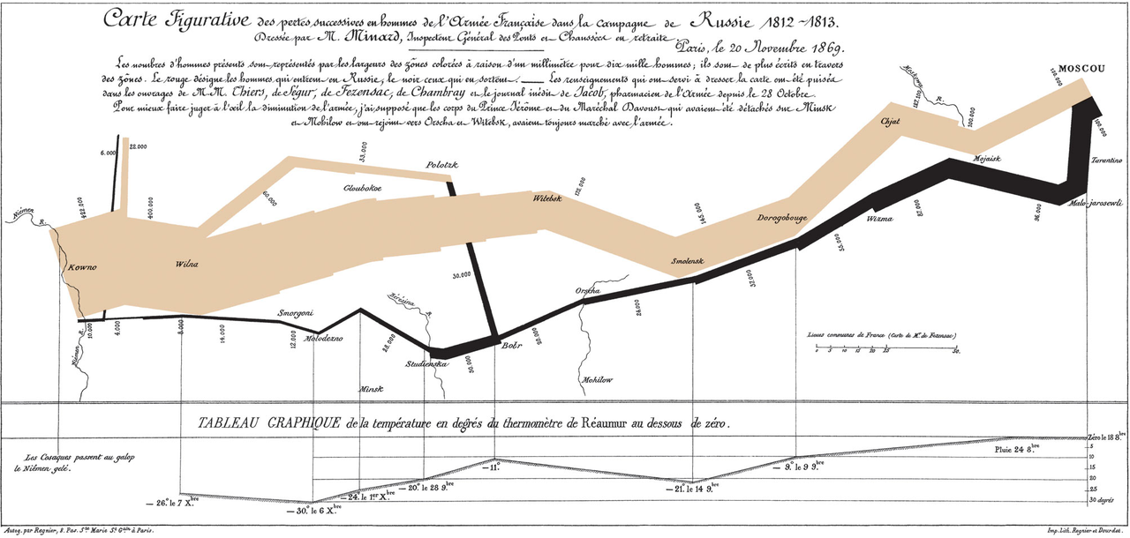
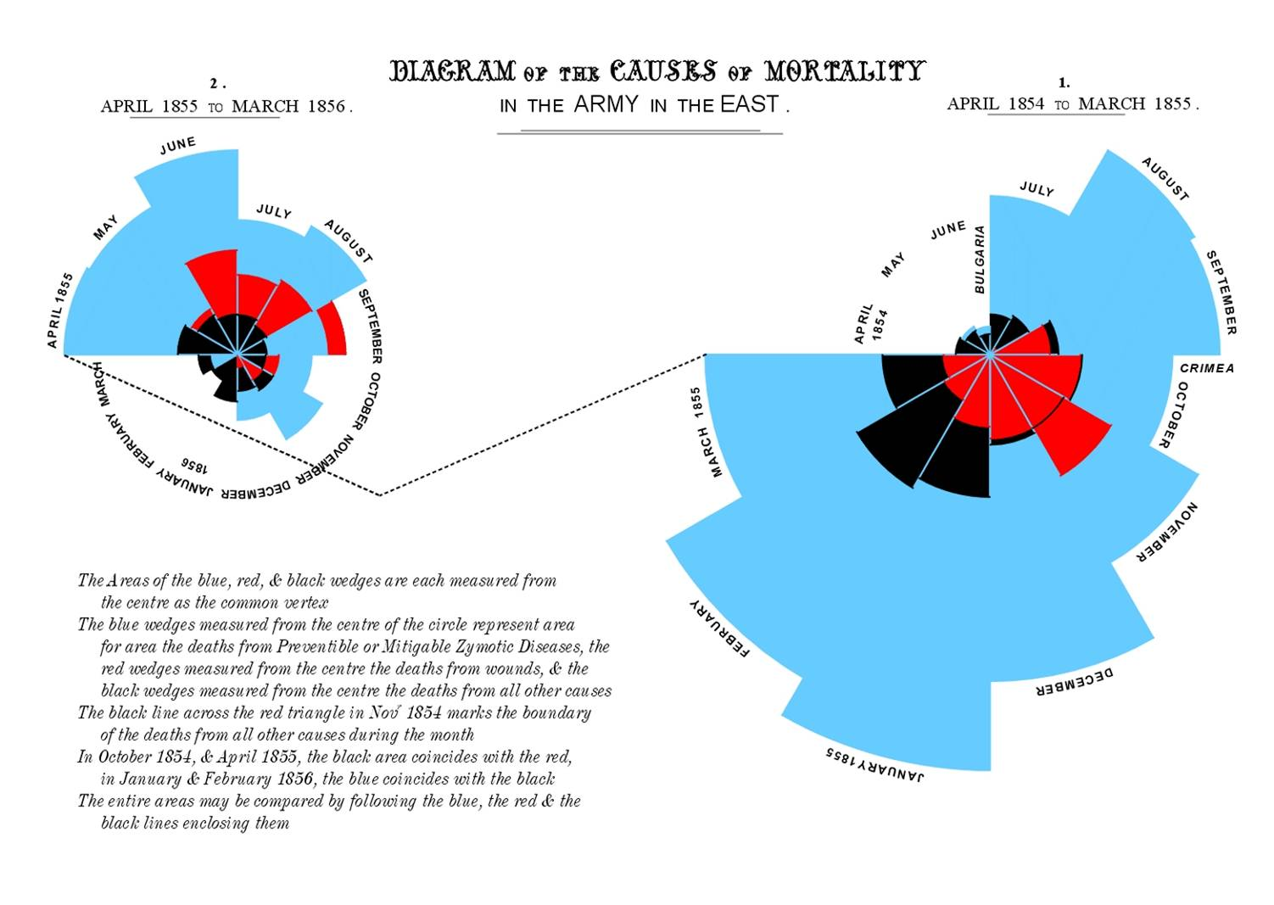
Outline

Slide 3
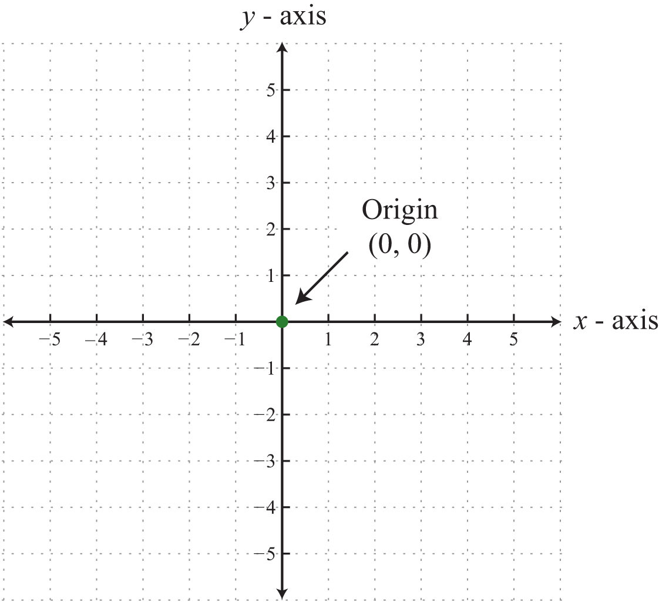
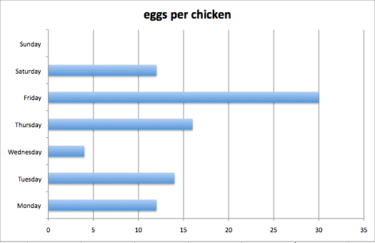
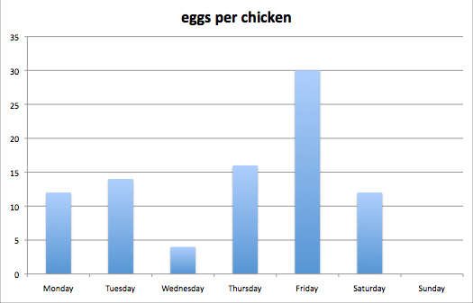
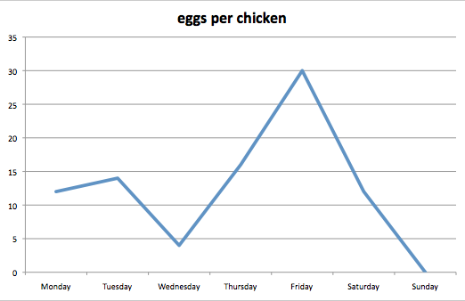
Cartesian Coordinate System
René Descartes, 1649

Slide 4
Economic and Demographic Historians
Tony Wrigley & R.S. Schofield, 1981.

Slide 5
The First Graph - 1644
Michael Florent Van Langren

Slide 6
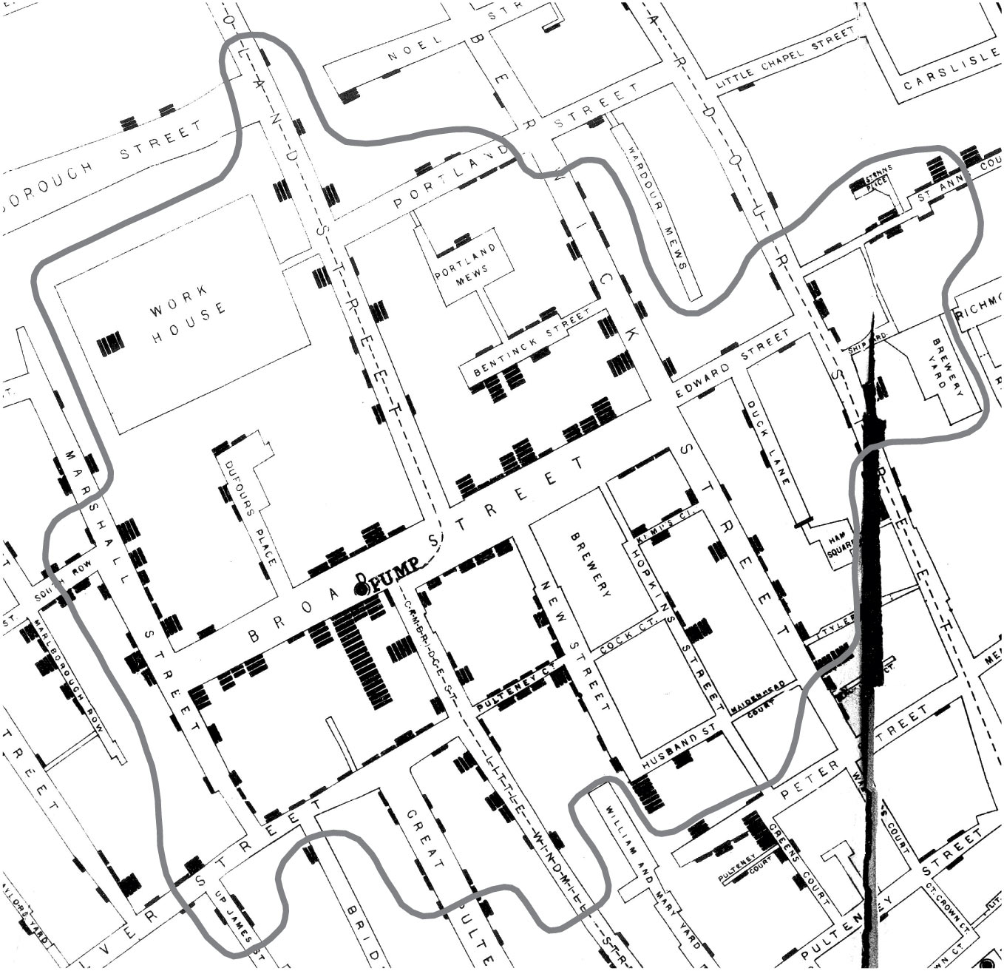
John Snow Cholera Map of London - 1854

Slide 7
The Birth of Nursing, 1856
Florence Nightingale

Slide 8
The Art of Dancing, 1735

Slide 9
Retreat from Moscow, 1812
Charles Joseph Minard, 1869

Slide 10
Historic Recap

Slide 11
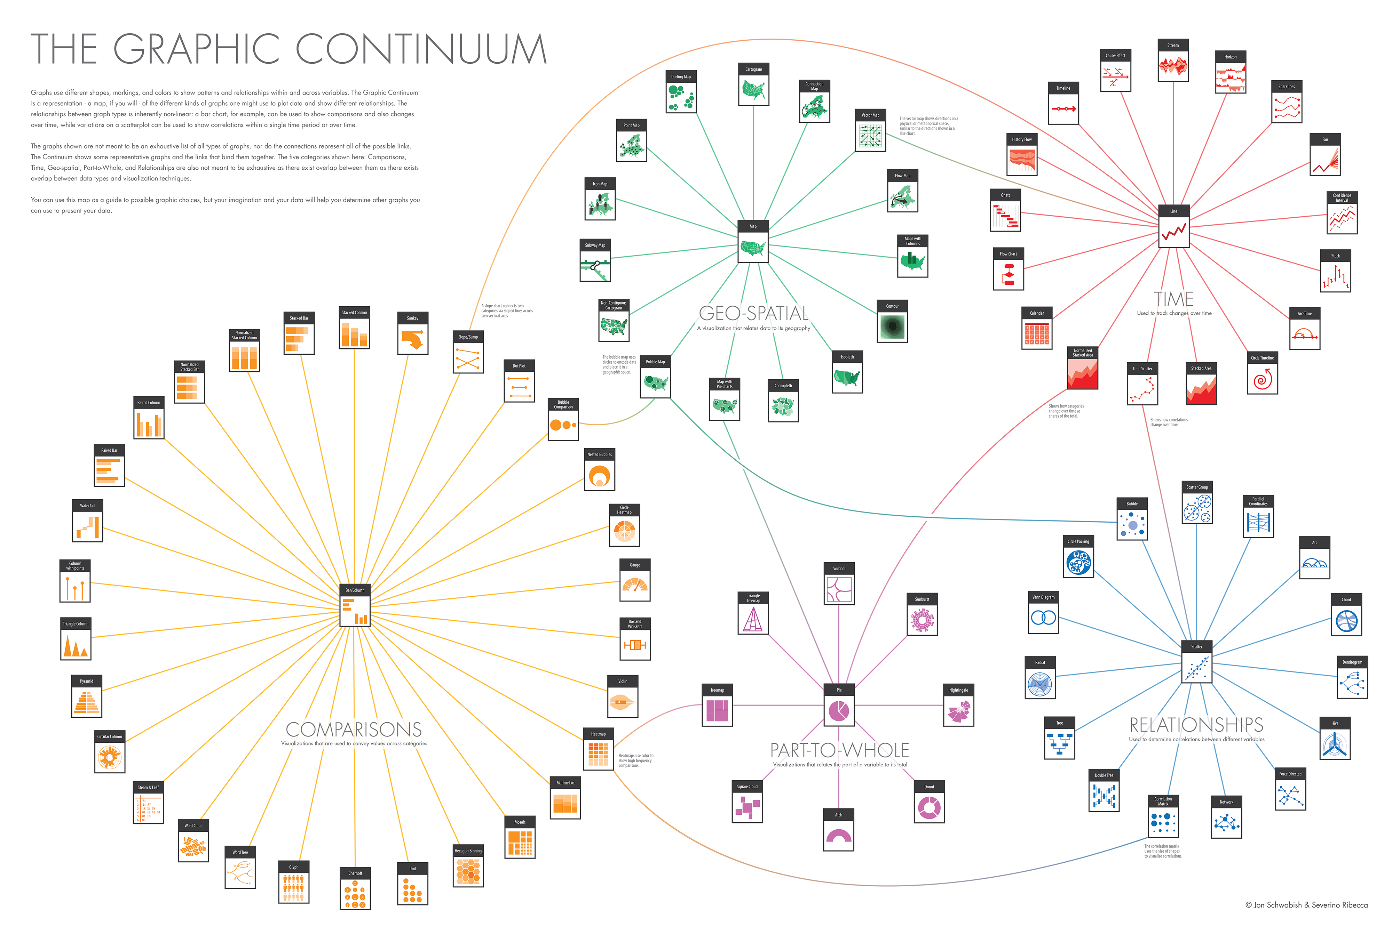

Slide 12
Field of Commemoration
http://poppyfield.org/
Valentina D’Efilippo, 2013.

Slide 13
200 Countries, 200 Years
http://www.gapminder.org/world/
Hans Rosling, 2013.

Slide 14
US Gun Deaths, 2013
http://guns.periscopic.com/?year=2013

Slide 16
Blindness in the United States

Slide 17
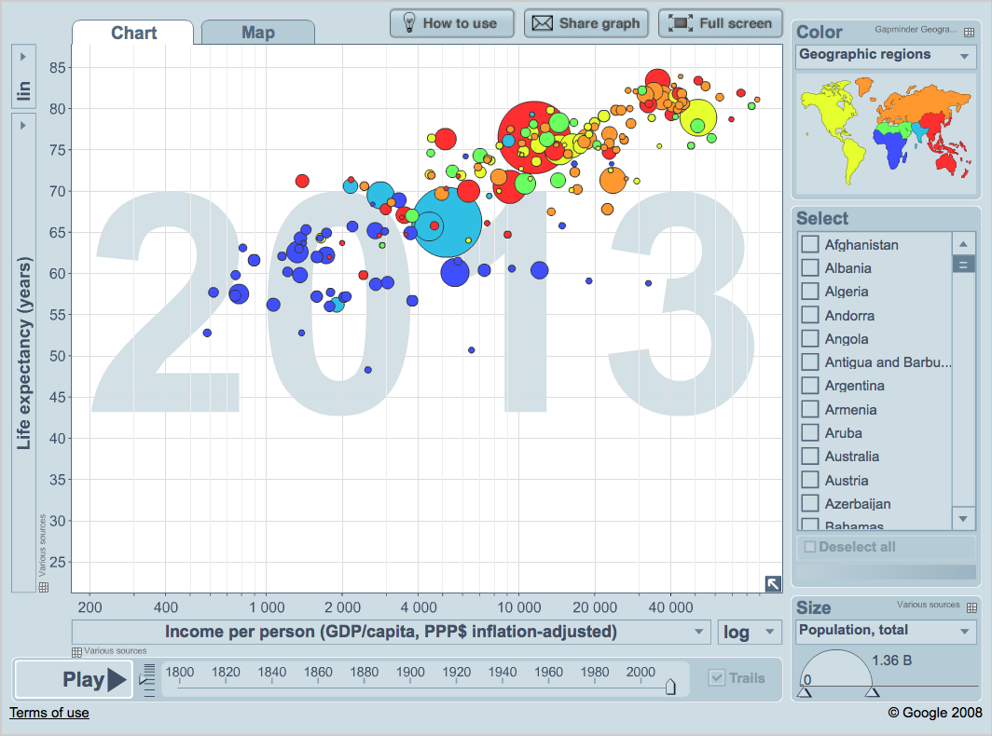
Conclusion

