Slide 1
Online Conversations in History
Intro to Digital History
Adam Crymble

Slide 2
Plan for Today
Getting to know you
Module Outline
What is Digital History?
Online Communication – Blogs & Twitter
Workshop:
Setting up blog
Setting up Twitter
Beginning our First Reflections

Slide 3
Weekly Readings
http://adamcrymble.org/intro-to-digital-history-2015

Slide 4
No Experience Necessary

Slide 5
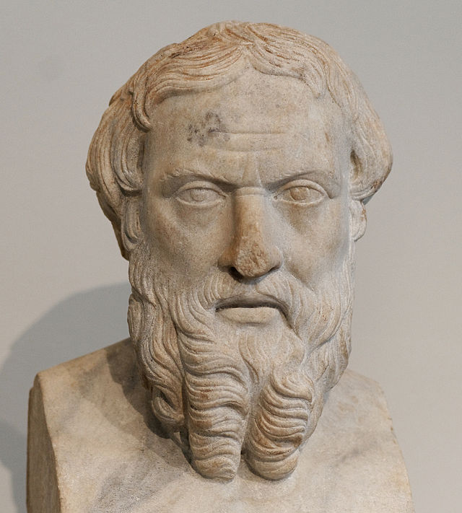
Remember – You’re a Historian
Herodotus, Wikipedia.

Slide 6
The Wayback Machine

Slide 7
The Wayback Machine

Slide 8
The Wayback Machine

Slide 9
Assignments
Review of Methodology Tutorial (30%)
Historical Transcription + Reflection (20%)
4 Critical Blog Posts (50%)

Slide 10
“DH”

Slide 11
What is Digital Humanities?
Digital Humanities is when humanities and computer technologies join to give us more information by looking at things through different lenses.
Nina Muggli,
University of British Columbia

Slide 12
What is Digital Humanities?
DH involves the use of computers either to conduct humanities research or to communicate its results.
Caleb McDaniel,
Rice University

Slide 13
What is Digital Humanities?
DH is the application of digital tools to traditional Humanities research and scholarship methodologies with an aim towards producing digital content, often in a collaborative environment.
Matthew Christy
Texas A&M University

Slide 14
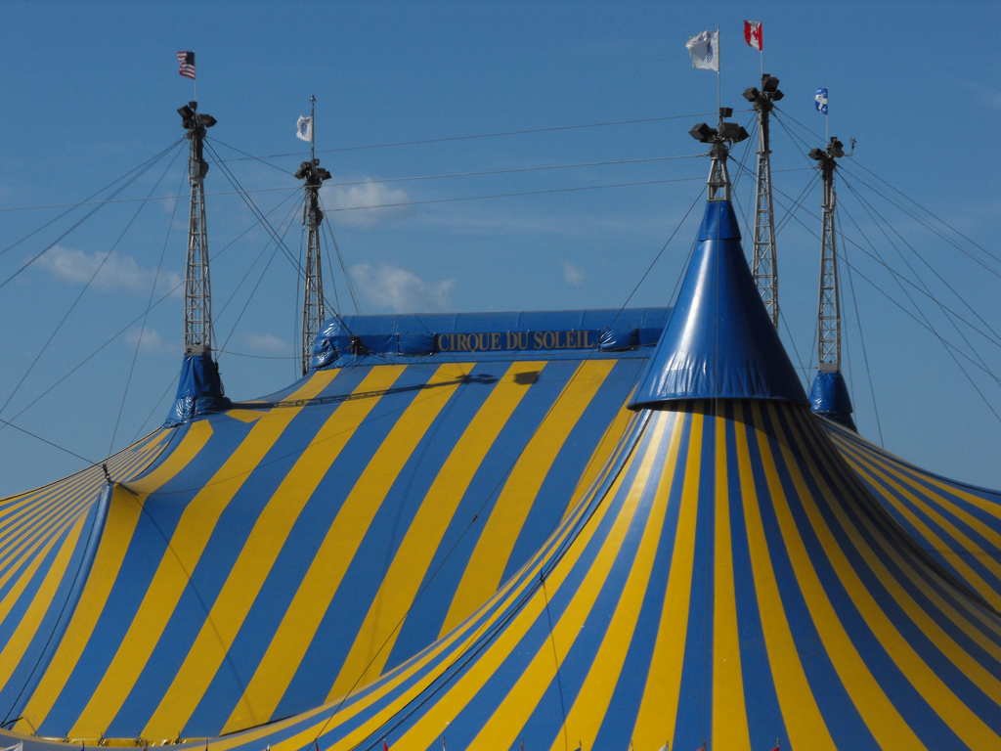
Digital Humanities - ‘The Big Tent’
‘Circus Tent’ by Tiffany Terry

Slide 15
‘The Big Tent’ – Cocktail Party
Historians
Non-Historians
Linguistics
Literature
Classics
Archaeology
History
Anthropology

Slide 16
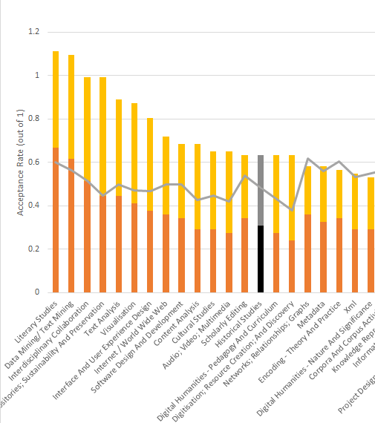
Digital Humanities 2013 Conference
Graph by Scott Weingart

Slide 17
‘The Big Tent’ – Cocktail Party
Historians
Non-Historians
Linguistics
Literature
Classics
Archaeology
History
Anthropology

Slide 18
‘The Big Tent’ – Cocktail Party
Text
Historians
Non-Historians
Objects
Images
Video
Sound

Slide 19
Digital Histories
Digital
Public History
Digital Research Methods

Slide 20
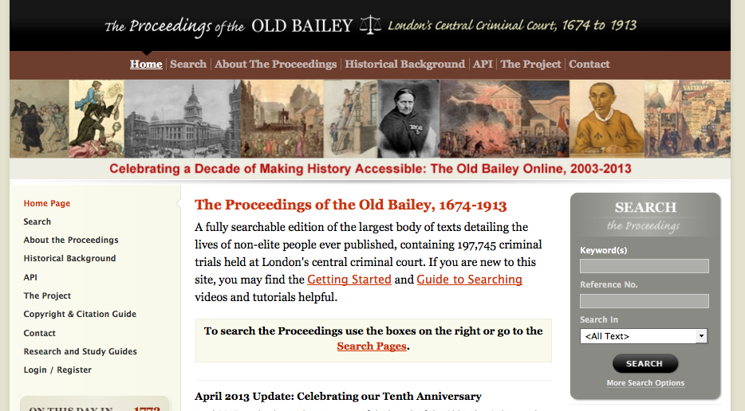
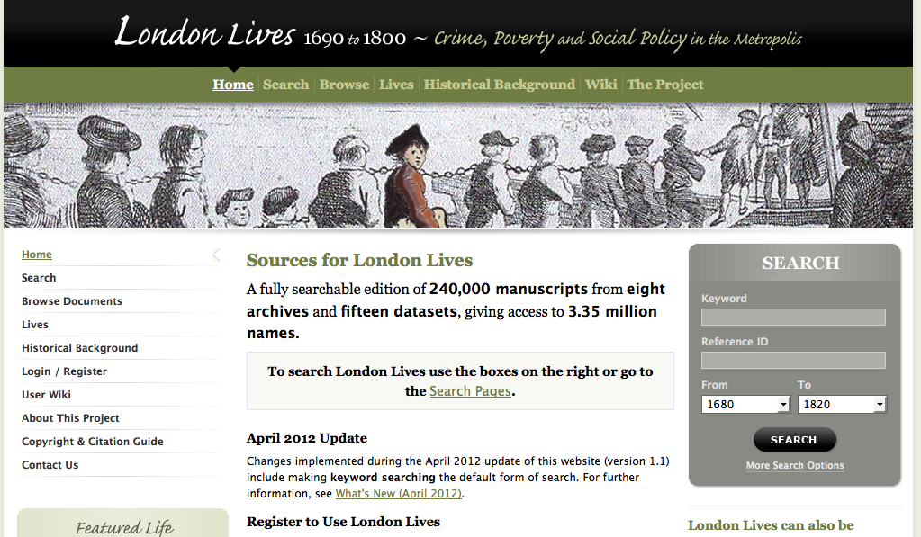
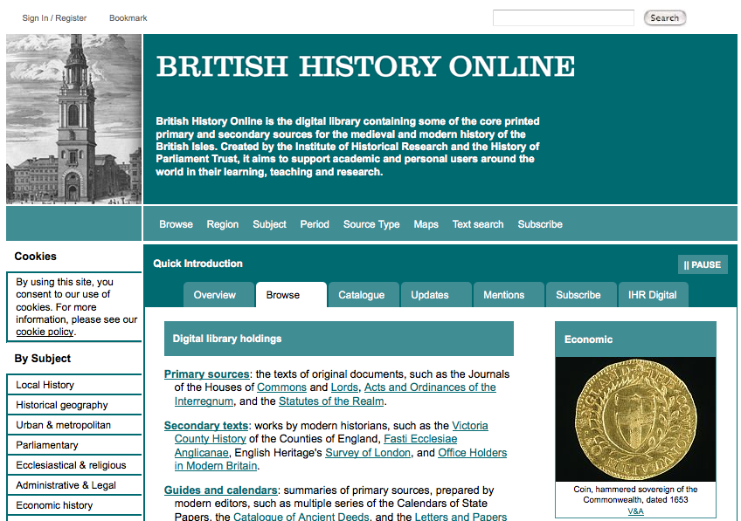
Digital Archives

Slide 21
Digital Memory

Slide 22
Digital Histories
Digital
Public History
Digital Research Methods

Slide 23
Topic Modeling
Paper Machines.

Slide 24
N-Gram Viewer

Slide 25
N-Gram Viewer

Slide 26
Digital Histories
Digital
Public History
Digital Research Methods
Us!

Slide 27
‘The Big Tent’ – Floor Plan
Historians
Non-Historians
Linguistics
Literature
Classics
Archaeology
History
Us!
Anthropology

Slide 28
Scholarly Conversations
Books (Monographs)
Peer Reviewed Journal Articles
Conference Presentations

Slide 29
New Venues for Communication
Academic Blogs
Twitter / Social Media
Books (Monographs)
Peer Reviewed Journal Articles
Conference Presentations

Slide 30
DH Now

Slide 31
Activity 1
This week we’re going to set up our blogs where we’ll be posting our reflections on the weekly activity. Get yourself a blog from WordPress.com and email me the URL (a.crymble@herts.ac.uk).
Spend 10 minutes adding in some basic details about you and your blog on an ‘about’ page. Mention that you are a digital history student at the University of Hertfordshire taking this course. Add a link to this module page on your about page, to make sure you know how to add links.
If you are finding WordPress unintuitive, you might need to check out one of their many tutorials at Learn WordPress.com.

Slide 32
Activity 2
Sign up for a Twitter account and follow some historians. Here’s a list to get you started:
Adam Crymble, @adam_crymble
Jennifer Evans, @historianjen
Ciara Meehan, @CA_Meehan
Tim Hitchcock, @TimHitchcock
Mia Ridge, @mia_out
James Baker, @j_w_baker
Amanda Vickery, @amanda_vickery
Jane Winters, @jfwinters
What types of conversations do you see occuring? Who are they following? What uses are the putting Twitter to? Do you think this would be useful as a tool for a historian? Why do you think digital historians in particular tend to like it so much?

Slide 33
Blog Post Topic
Write your first reflection on Twitter as a tool for historians. Make sure you consider the views in the Core Reading. If you draw upon someone else’s ideas, make sure you give them proper credit; on a blog post that could mean a citation at the bottom of the post, or you could link to where they made the claim. The latter is generally more in the spirit of how the Internet works.

