Slide 1
Content Management Systems (CMS)
Adam Crymble
Digital Histories Workshop

Slide 2
Outline
Content Management Systems (CMS)
Widgets / Plugins / Add-ons / Modules
How to use a CMS
Choosing the right CMS for you

Slide 3
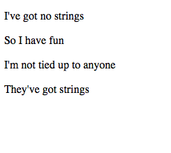
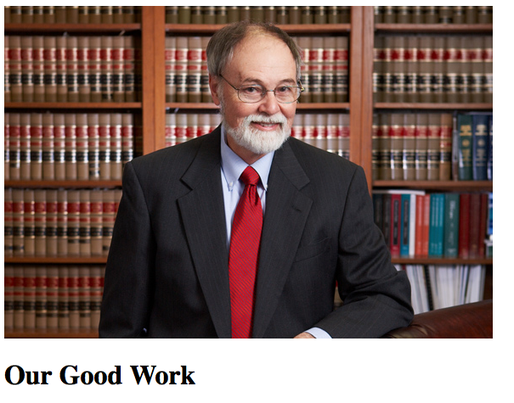
‘Hand-coding’ HTML

Slide 4
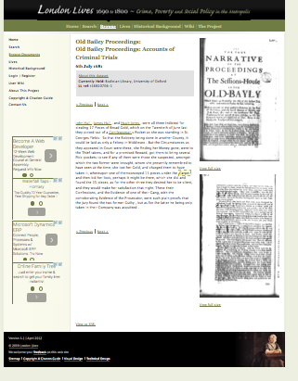
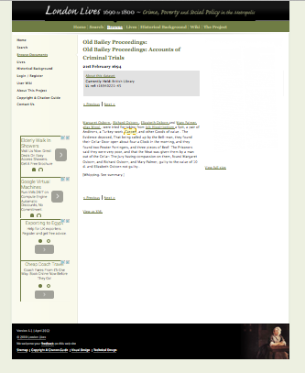
Common Elements

Slide 5
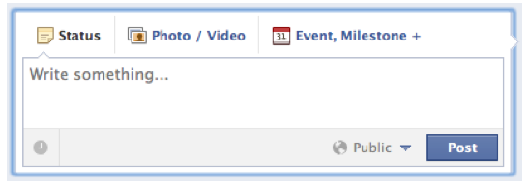
Facebook CMS

Slide 6
WYSIWYG (What you see is what you get)

Slide 7
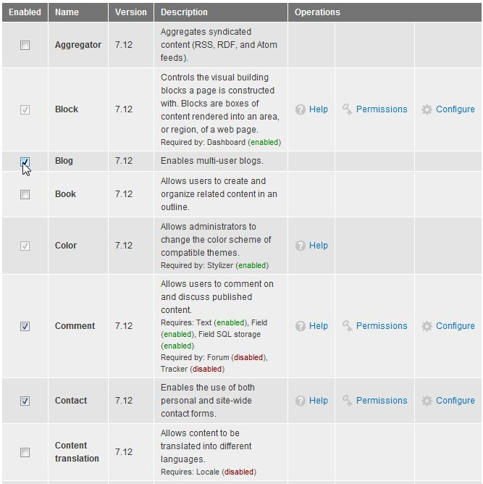
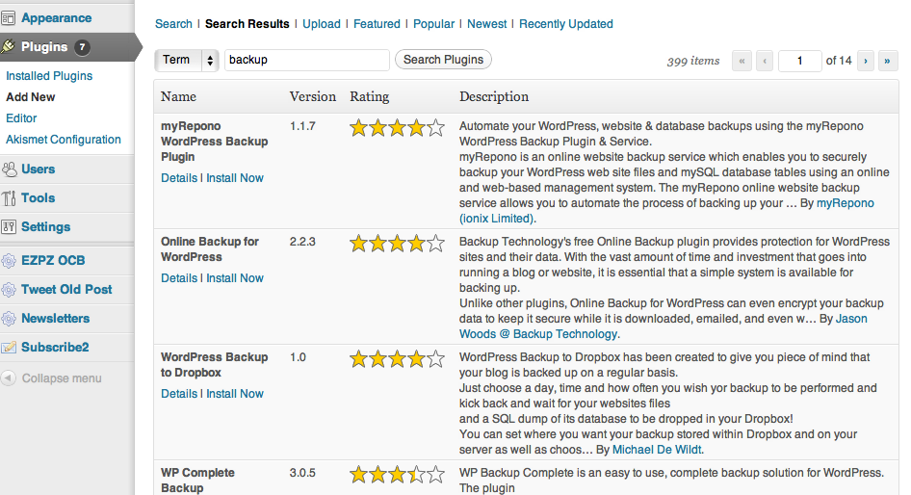
CMS Widgets / Plugins / Add-ons / Modules

Slide 8
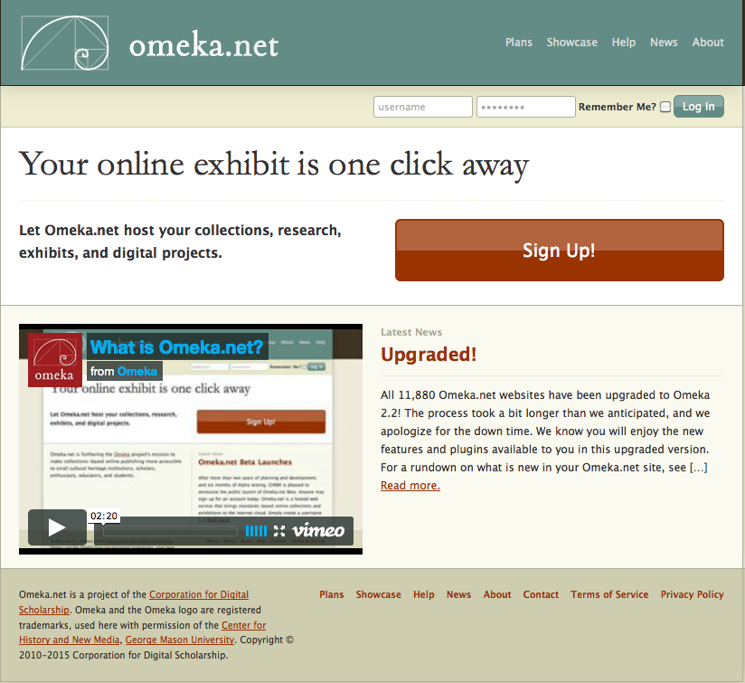
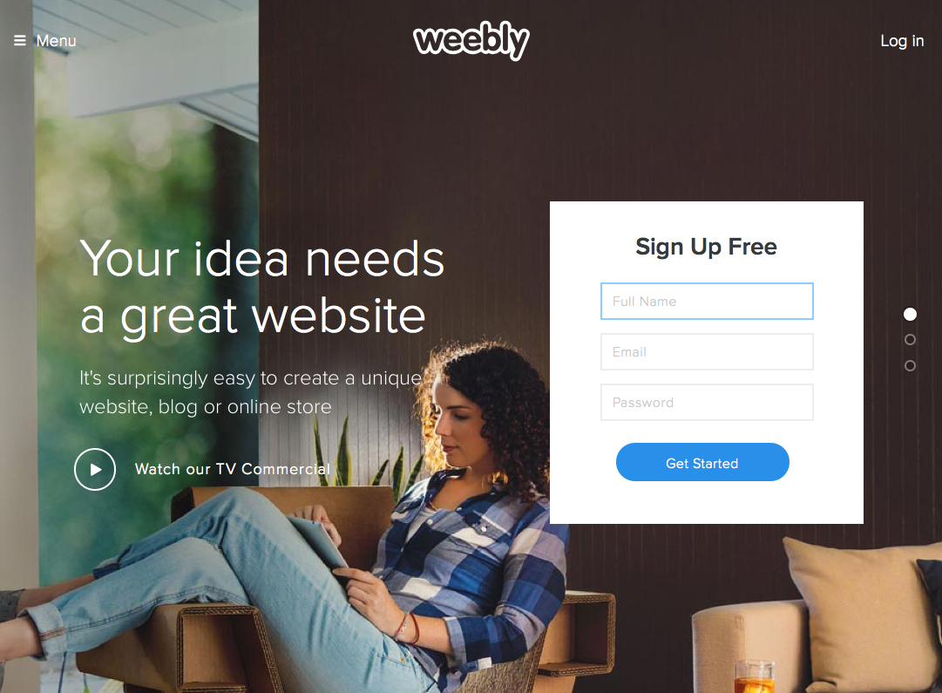
How to Use a CMS

Slide 9
Summary
Content Management Systems (CMS)
Widgets / Plugins / Add-ons / Modules
How to use a CMS

Slide 10
Activity
We’re each going to test out a different Content Management Systems (CMS) that is freely available. We’ll think about the strengths and weaknesses of each, as well as the learning curve required to get up and running.
Then we’ll report back to the class on each. Watch at least ONE (1) video on YouTube that showcases your CMS so that you can see it in its ideal state as well as experience it hands-on.
You DO NOT need to pay for any of these, though most will offer pay services. Please use the free version for the workshop.

