Slide 1
How the Web Works
Digital Histories Workshop
Adam Crymble

Slide 2
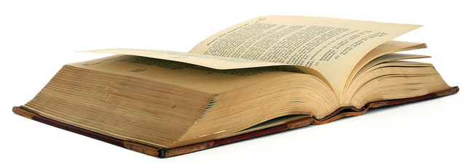
A place to store information
‘Book 8’ by Brenda Clarke

Slide 3
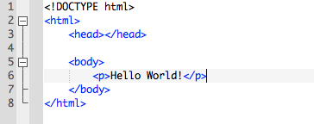
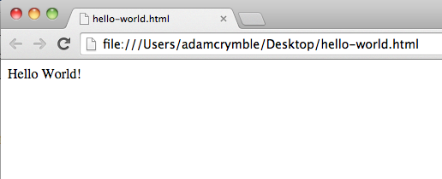
A Webpage to a Computer

Slide 4
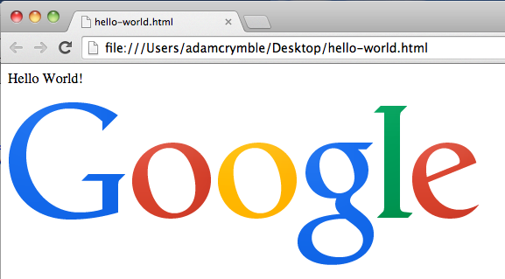
A Webpage to a Computer

Slide 5
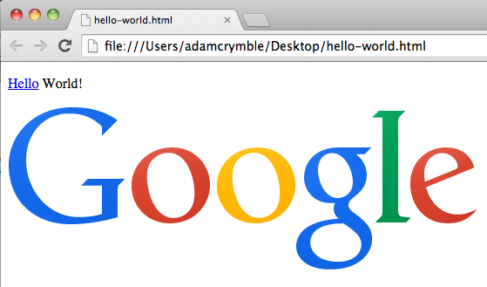
A Webpage to a Computer

Slide 6
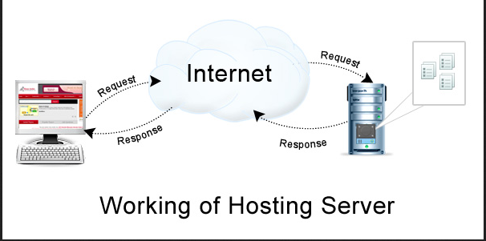
Servers

Slide 7
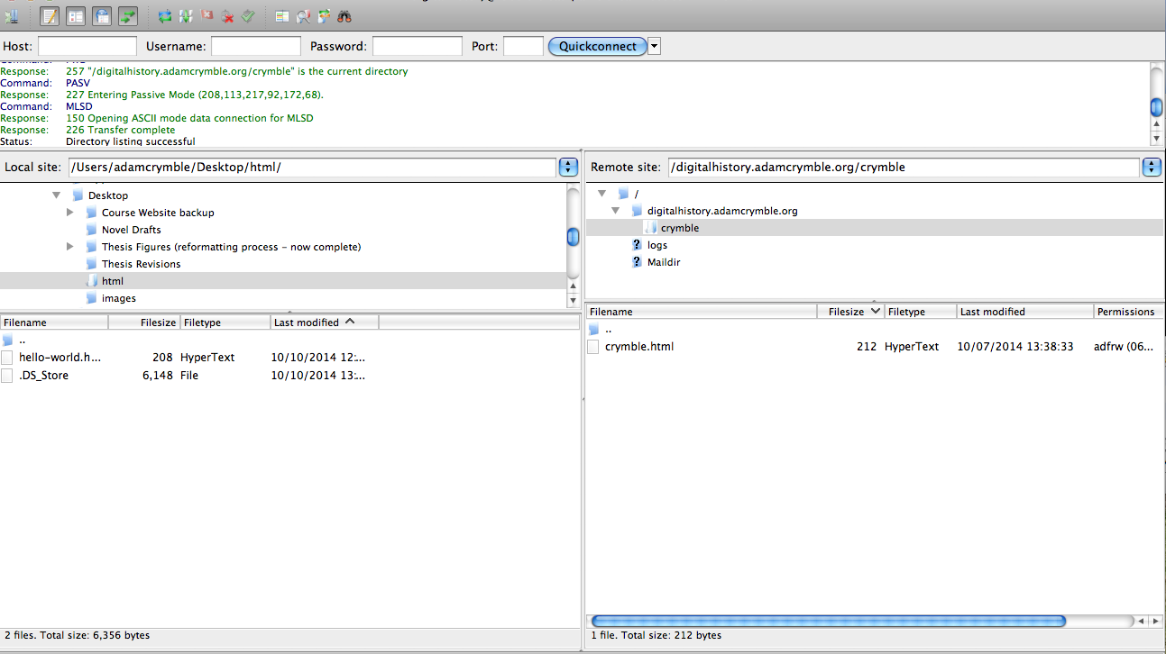
FTP (File Transfer Protocol)

Slide 8
URLs
http://mysite.com/pickles/onions/carrots/peas.html
Folder
Folder
Folder
Domain
Name
(or ‘root’)
HTML file

Slide 9
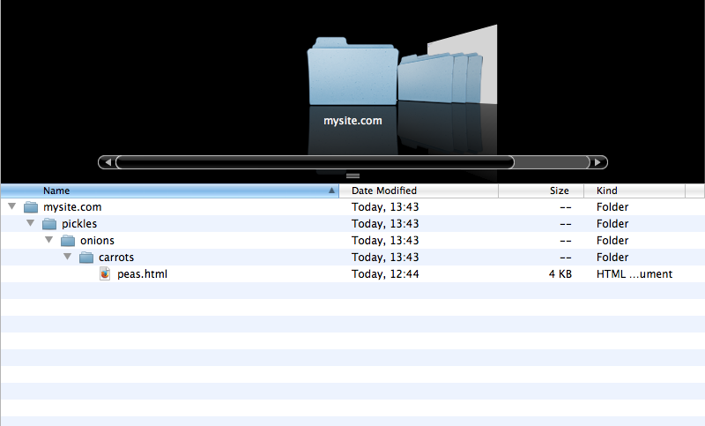
Just folders and files

Slide 10
Languages of the web
Markup
Hypertext Markup Language (HTML)
Extensible Markup Language (XML)
Style Sheet
Cascading Style Sheets (CSS)
Scripting Databases
JavaScript MySQL
PhP

Slide 11
How (really basic) Websites Work
A bunch of files (HTML, images, audio, etc)
In a bunch of folders
On a server

