Slide 1
Digitisation & Working with Data
Adam Crymble
Digital Histories Workshp

Slide 2
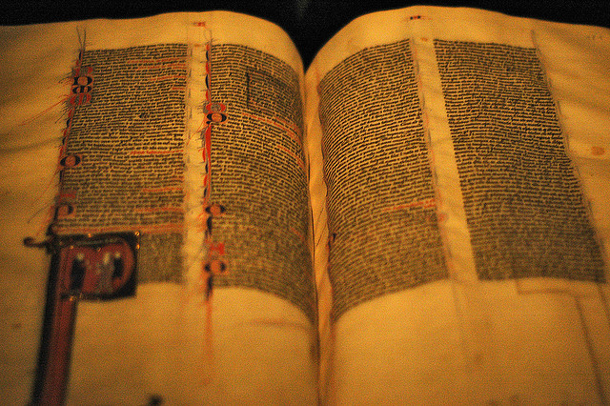
Data as an Input
Uses brain to simplify, and then analyse, based on some ‘test’
Forms
Conclusions
Input selected
Monks were
very good at Latin
“Old Book” by Ivan Pik, and “Thinking” by Sebastiaan ter Burg

Slide 3
Data as an Input
Runs inputs through
an algorithm (a ‘test’)
Forms
Conclusions
Input selected (already been simplified)
“Microbee Computer-In-A-Book”, by Adam Jenkins

Slide 4
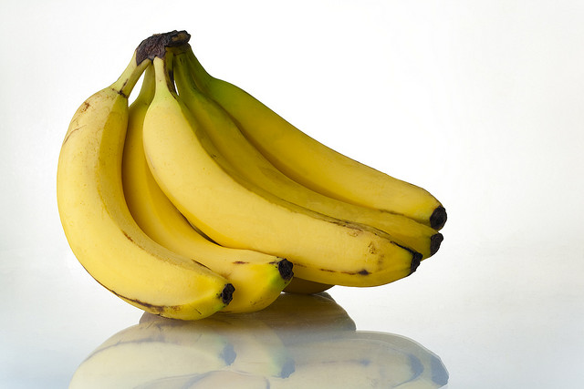
Data as an Input
Uses brain to simplify, and then analyse, based on some ‘test’
Forms
Conclusions
Input selected
Tasty!
“Bananas” by Billy Wilson, and “Thinking” by Sebastiaan ter Burg

Slide 5
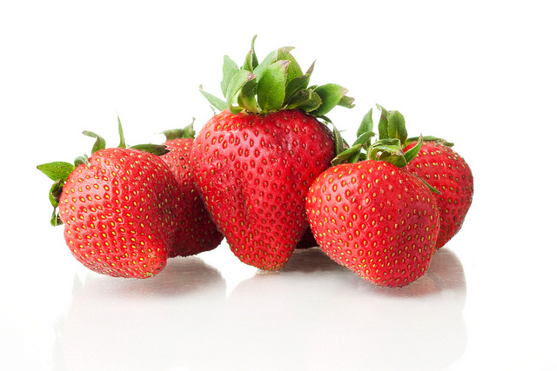
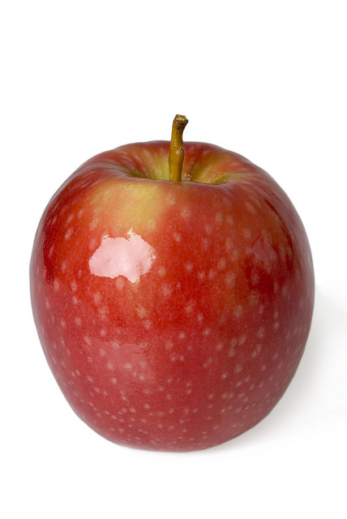
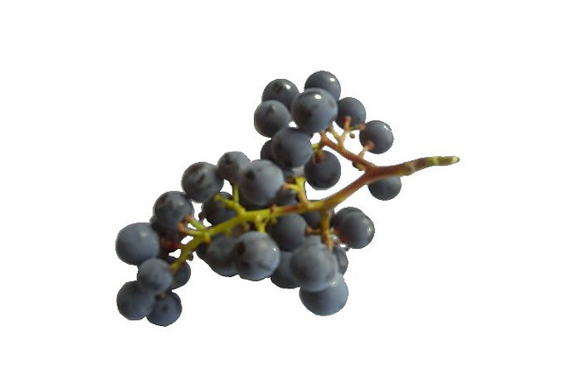
Data as an Input
Uses brain to simplify, and then analyse, based on some ‘test’
Forms Conclusions
(in this case, adds structure)
Input selected
Red Ones
Yellow Ones
“Bananas” by Billy Wilson, and “Thinking” by Sebastiaan ter Burg

Slide 6
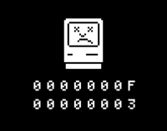
Data as an Input
Runs inputs through
an algorithm (a ‘test’)
Does not
Compute!
Input selected (in unsimplified form)
“Bananas” by Billy Wilson, and “Microbee Computer-In-A-Book”, by Adam Jenkins

Slide 7
Digitisation – Preservation and Portability
“Library Microfilm Reader & Printer” by Cushing Memorial Library

Slide 8
Digitisation – Electronic Text
Tim Hitchcock and Bob Shoemaker with the Old Bailey Online website, 2003.

Slide 9
Steps of Digitising the Old Bailey Online
Find the original records
Get scans of the originals
Double-rekey all of the text
Put it online

Slide 10
Input to Analysis: a few seconds
Voyant Tools

Slide 11
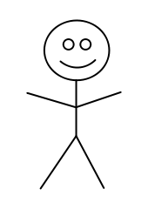
But what is lost?
I am Wayne
Rooney

Slide 12
The Mona Lisa
“La Jaconde”, by Leonardo da Vinci

Slide 13
The Mona Lisa?
“Mona Lisa”, by Larry Moss

Slide 14
This is not a pipe.
‘The Treachery of Images’, by René Magritte

Slide 15
The Back of a Canvas
“The Finely Executed Trompe L’Oeil Painting of the Back of a Canvas” by Russian School.

Slide 16
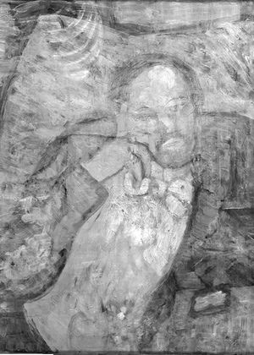
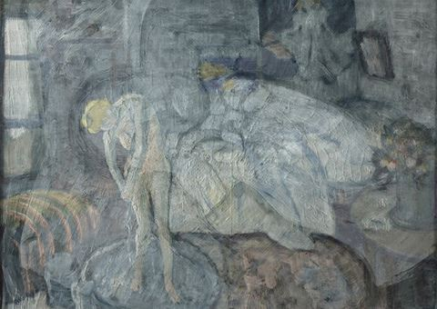
Which Light Spectrum?
“The Blue Room” by Pablo Picasso

Slide 17
Dry Point Gloss (etched with stylus but no ink) – DULFUH?
Photo by Bill Endres

Slide 18
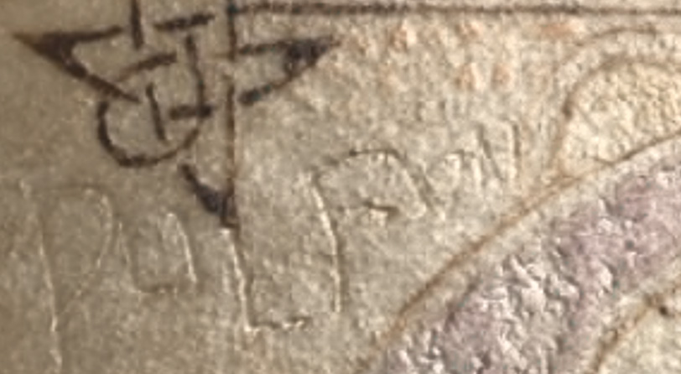
Or DULFUN?
Photo by Bill Endres

Slide 19
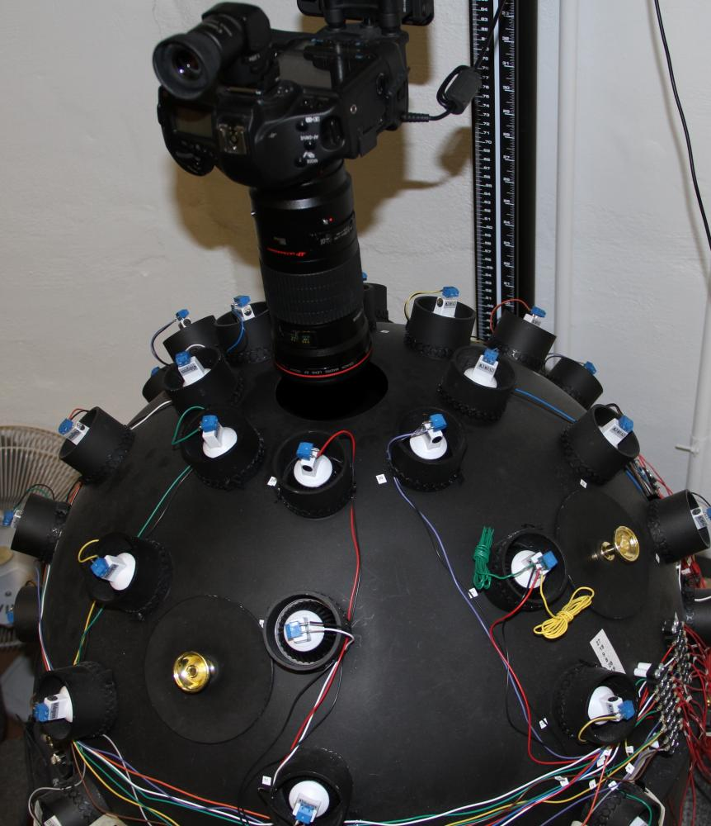
Reflectance Transformation Imaging
Photo by Bill Endres

Slide 20
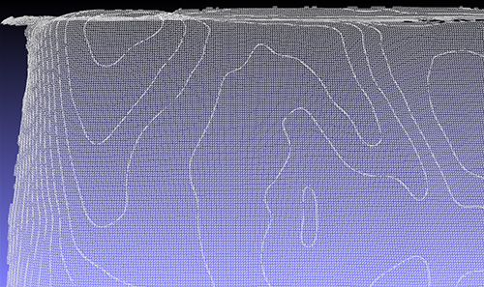
Measuring Stresses on the page
Photo by Bill Endres

Slide 21
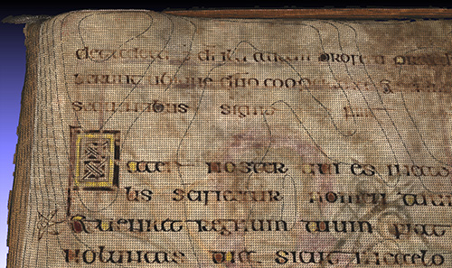
Measuring Stresses on the Page
Photo by Bill Endres

Slide 22
Transcription Only

Slide 23
Optical Character Recognition (OCR)
http://www.micro.dibe.unige.it/Research/OCR.htm

Slide 24
Messy Data
Tnis ls whot eigkty percemt accurecy louks lilce

Slide 25
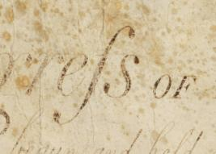
What is “J. rifh”?
OCR example, via Connectedhistories.org, and Long-S example, US Bill of Rights.

Slide 26
What is any of this?
OCR example, via Connectedhistories.org

Slide 27
Vinegar?

Slide 28
A crown?
Crown of Henry VIII, by Historic Royal Palaces

Slide 29
‘Beam me up, Scottie’
Star Trek teleporter

